Slide 1
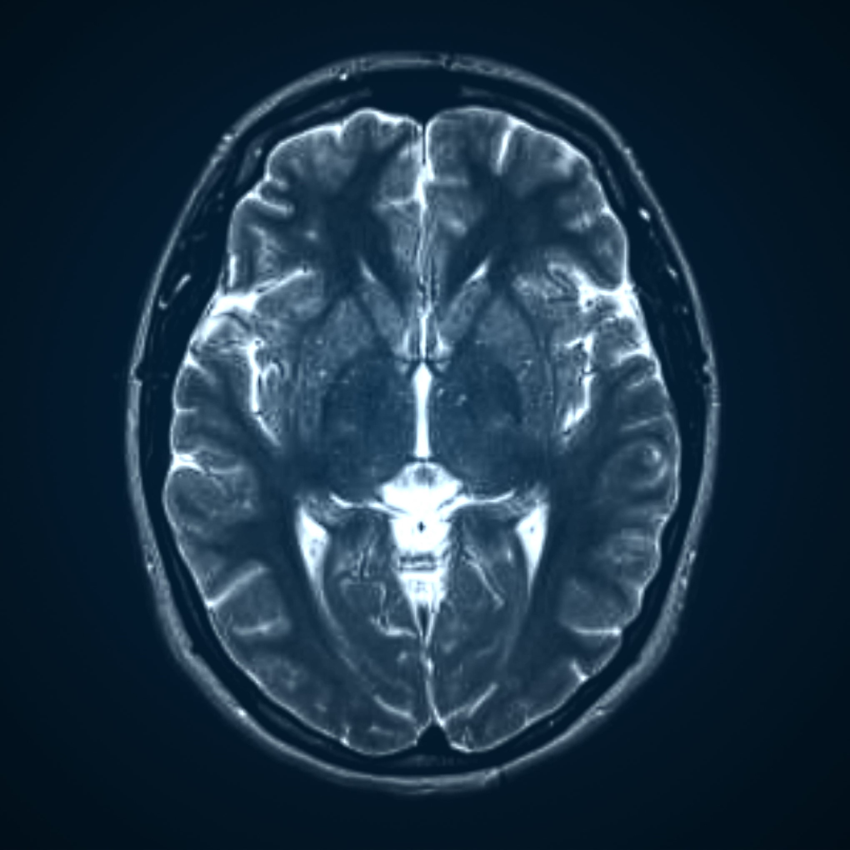
EXTRACTION AND VISUALIZATION OF ANATOMICAL ATLASES
2D and 3D Brain MRI Segmentation

Slide 2
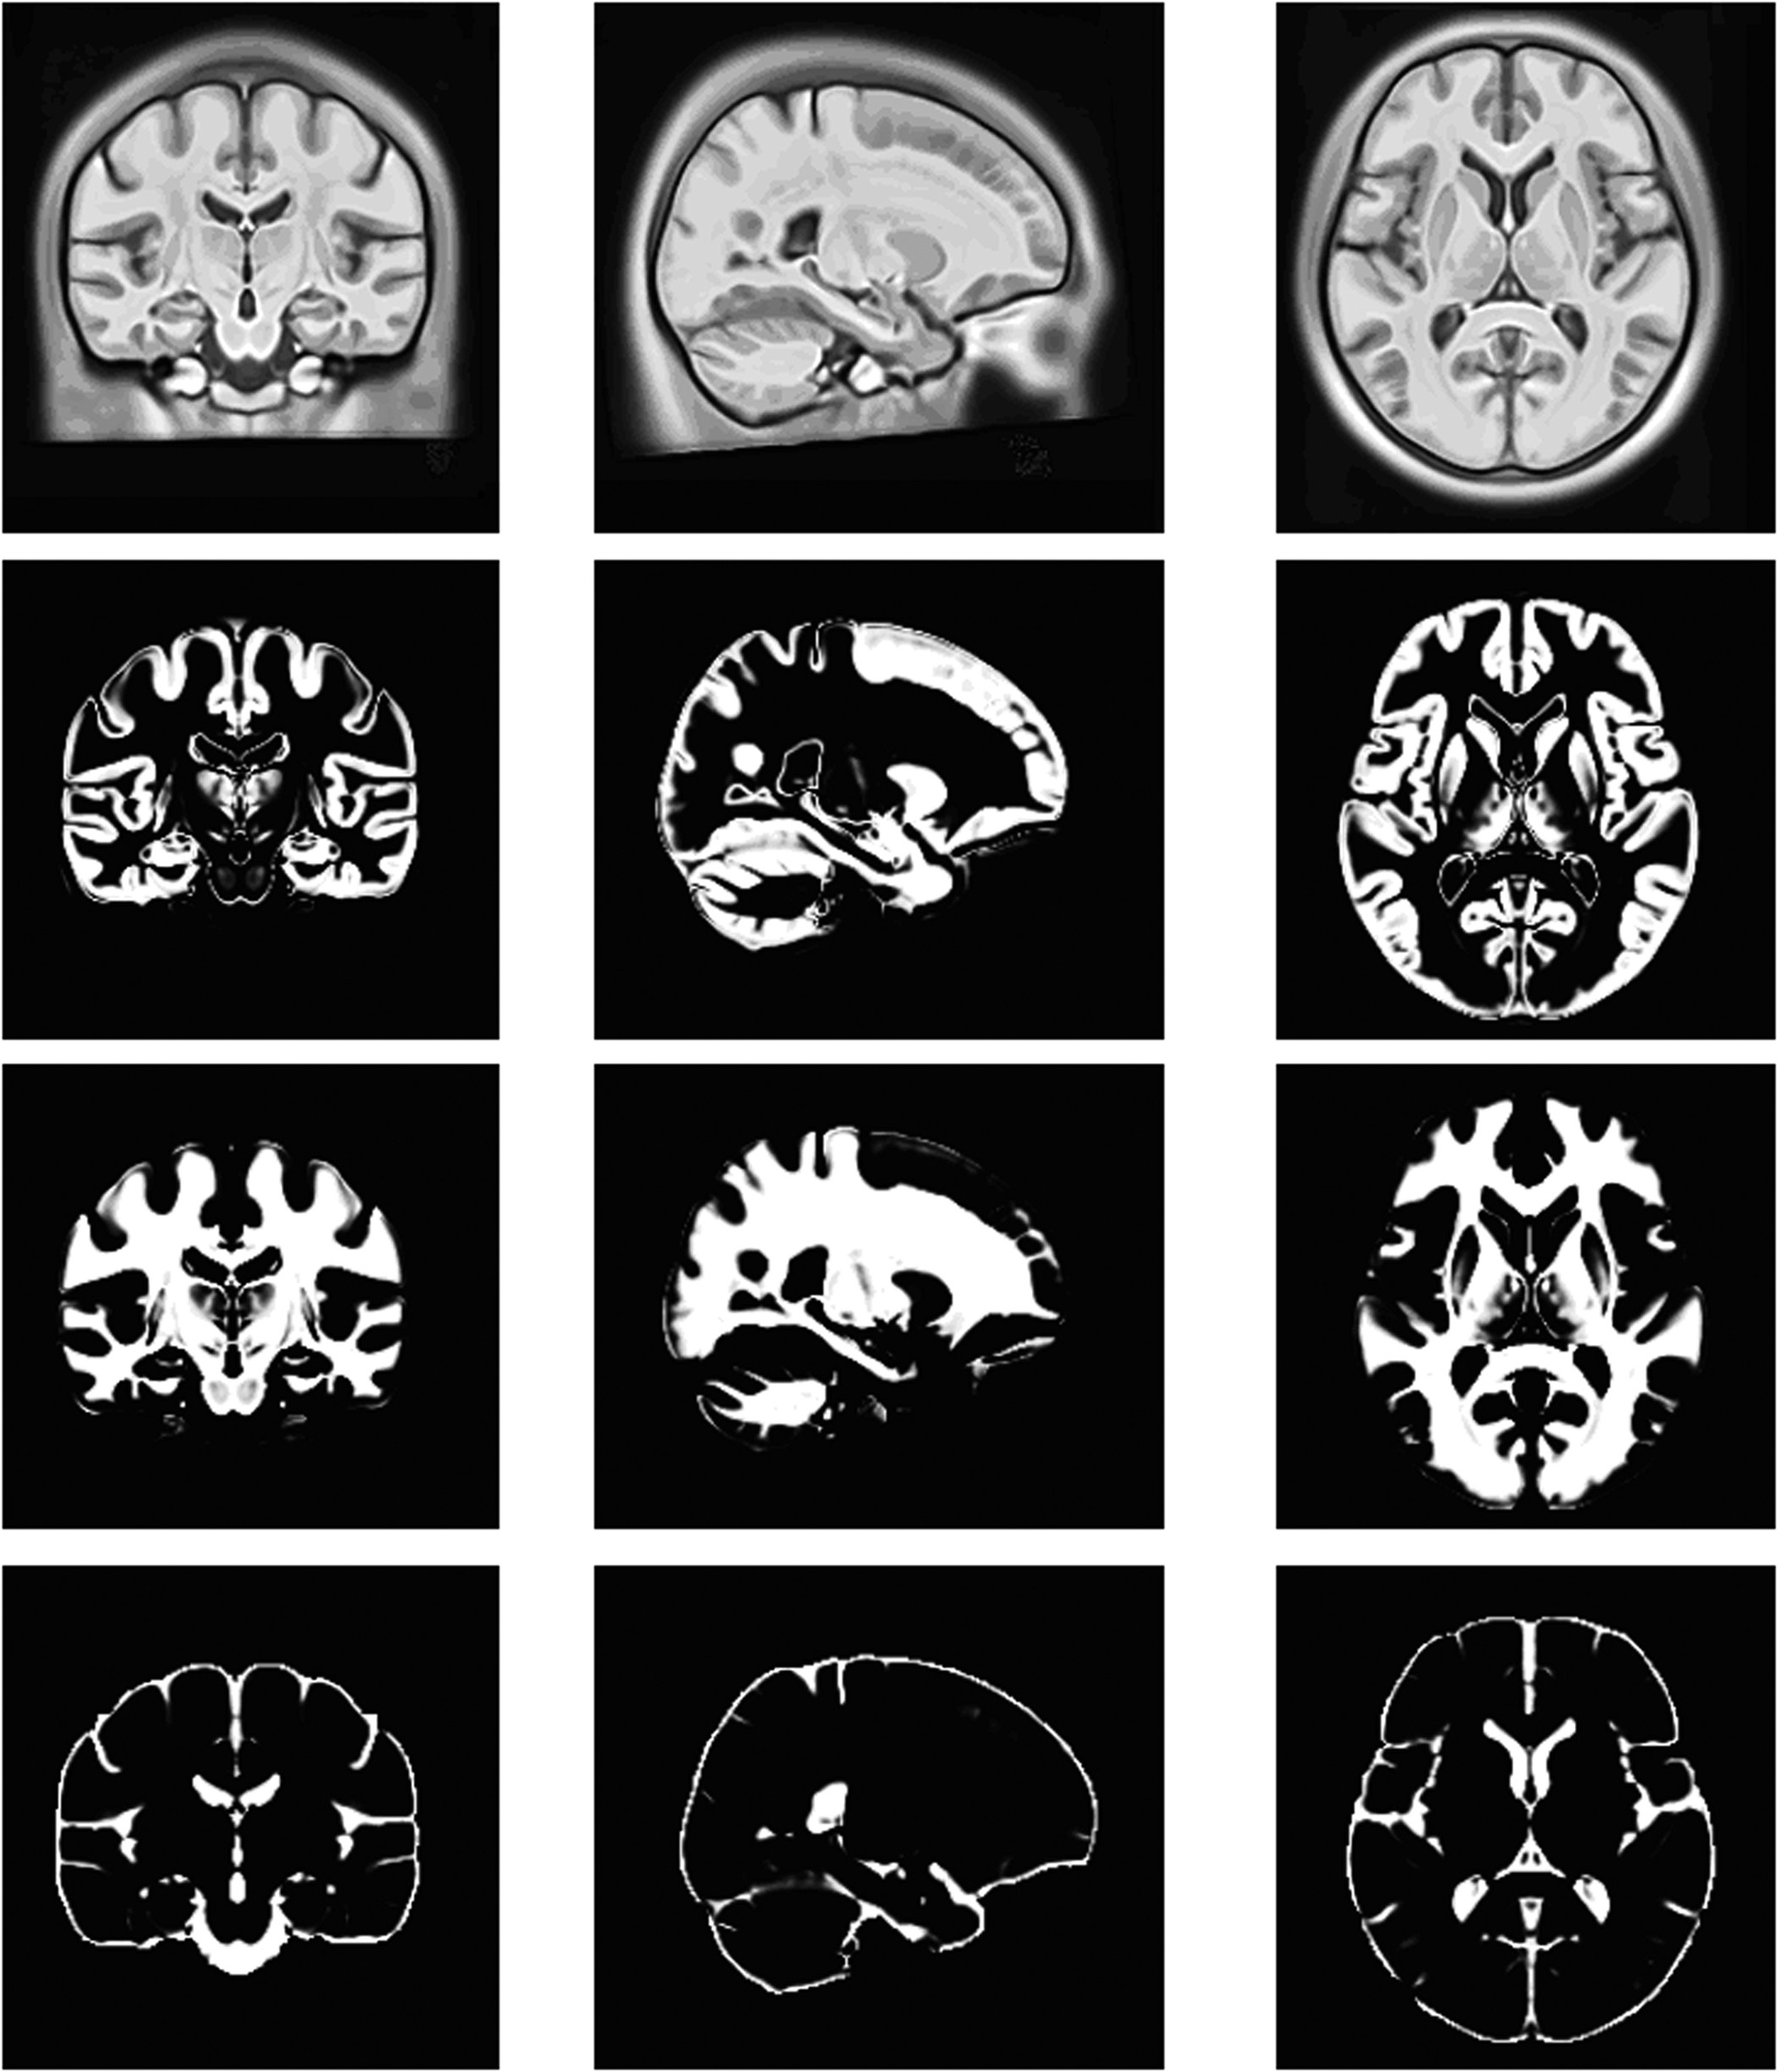
Outline
Index
Team members
What are we trying to build
Abstract
Business Use Case
Important Use case
Concepts Used
Our data
How we Process data
Algorithm
Comparison of Models
Optimal Case
Diagrams and Virtualizations
Final Recommendation
Challenges Faced
Our learning
Future Enhancements

Slide 3
Index
OUTLINE
AIM
ABSTRACT
BUSINESS USE CASE
CONCEPTS USED
DATA AND ITS PROCESSING
ALGORITHM
COMPARING MODELS
DIAGRAMS AND VIRTUALIZATIONS
FINAL RECOMMENDATION
CHALLENGES FACED
OUR LEARNING
FUTURE ENHANCEMENTS

Slide 4
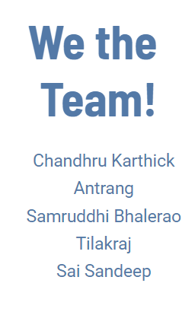
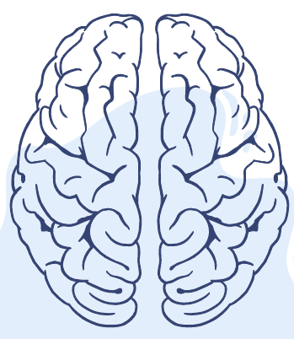
Weights & Biases

Slide 5
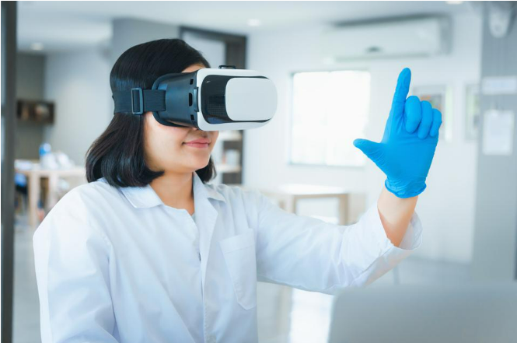
What we are trying to build?
An accurate visualization tool to view the Region of Interest for surgeons and doctors to ease treatment planning before surgeries. To have access to the expertise of doctors all round the world in tele-surgery room.

Slide 6
Abstract
Image segmentation is one of the most important tasks in medical image analysis and is often the first and the most critical step in many clinical applications.
In brain MRI analysis, image segmentation is commonly used for measuring and visualizing the brain's anatomical structures, for analyzing brain changes, for delineating pathological regions, and for surgical planning and image-guided interventions.
In the last few decades, various segmentation techniques of different accuracy and degree of complexity have been developed and reported in the literature.
The core goal is to extract region of interests from 3D scans of a patient.

Slide 7
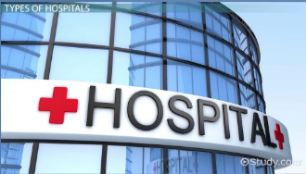
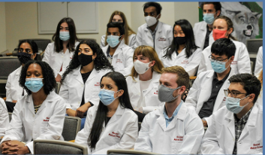
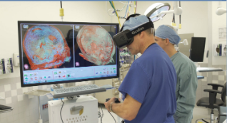
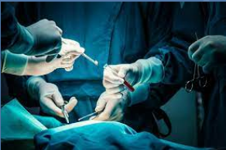
Business Use Case
Hospital
Medical School
Medical Research
MEDICAL SURGERIES

Slide 8
Important Use Case
HOSPITAL AND MEDICAL SURGERIES
S
Brain surgeries are delicate and complex to navigate.
It’s better than Manual Segmentation, automatic and semi-Automatic segmentation.
Usually surgeons do treatment planning from MRI scans on their computers
However, this can be sophisticated with deep learning if the 3D ROI can be extracted and visualized accurately in VR
If implemented in VR , doctors worldwide can collaborate and seek second opinion.

Slide 9
Challenges Faced
First and foremost challenge is procuring the dataset, the first lead obtained was the BraTS 2020
It has a few hundred Multi Region Tumor scans of different patients
It also has a csv file of survivability prediction for the same cancer patients, hence a 2-fold Deep learning model can be optimized
Testing it’s actual use case in VR Goggles has to be experimented with doctors/surgeons in hospitals. This can be costly for deployment
High end GPUs are required as we are dealing with large CV models with 3D Kernels and images are no longer 2D!
Scalability and compression has to be observed to see feasibility for deployment in VR headsets
A general model that can handle small and large organs/multiple regions.etc
Speed and Efficiency

Slide 10
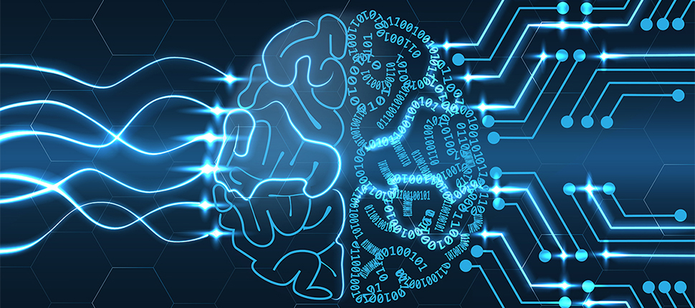
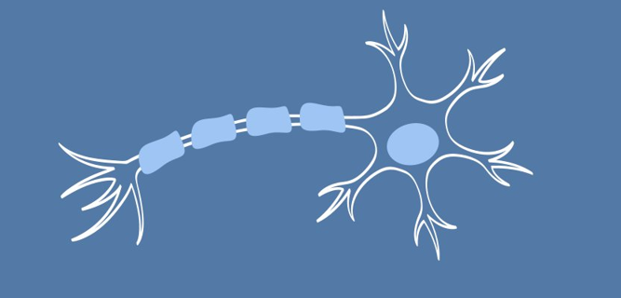
Concepts Used
CONVOLUTIONAL NEURAL NETWORKS
UNET SEGMENTATION MODEL
ADAM OPTIMIZER
IMAGE PRE-PROCESSING
STOCHASTIC WEIGHTED AVERAGING
3D CONVOLUTIONS
BATCH NORMALIZATION

Slide 11
Our Data
DATA PREPARATIONS
DATA OVERVIEW
Brain MRI Scan in 3 Modalities (Flair, T1, T2). 369 3D MRI Images in Training. 125 MRI Images for Testing.
For the 2D Model mid planes of the tumor region was used to train UNet model. For the 3D model, the kernel parameters were modified and trained on the whole 3D dataset
DATA COLLECTION
BraTS2020 utilizes multi-institutional pre-operative MRI scans and primarily focuses on the segmentation of intrinsically heterogeneous (in appearance, shape, and histology) brain tumors, namely gliomas.

Slide 12
How we Processed Data
.NII FILE
FLAIR IMAGES, T1-CONTRACT ENHANCHED
3D VOLUMES WITH 155 SLICES
TRIMMED OFF FIRST AND LAST 5 SLICES
WE USE 5TH TILL 150TH SLICES
EACH SLICE IS NORMALIZED
RESIZED TO 240x240
[GANs TO TRANSFORM MODALITY COULD BE EXPLORED]

Slide 13
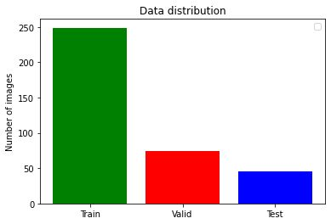
Data Distribution

Slide 14
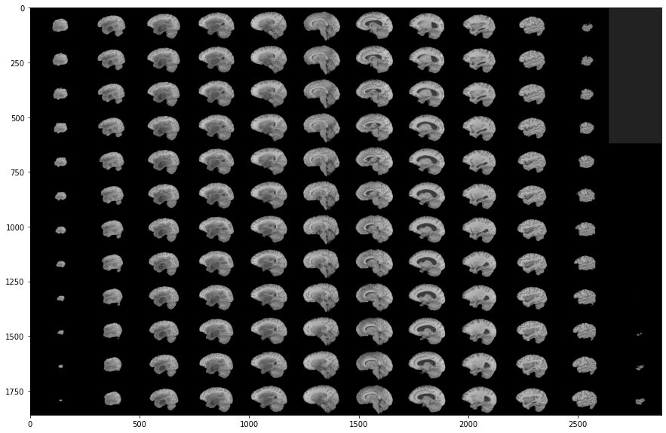
Data Visualisation

Slide 15
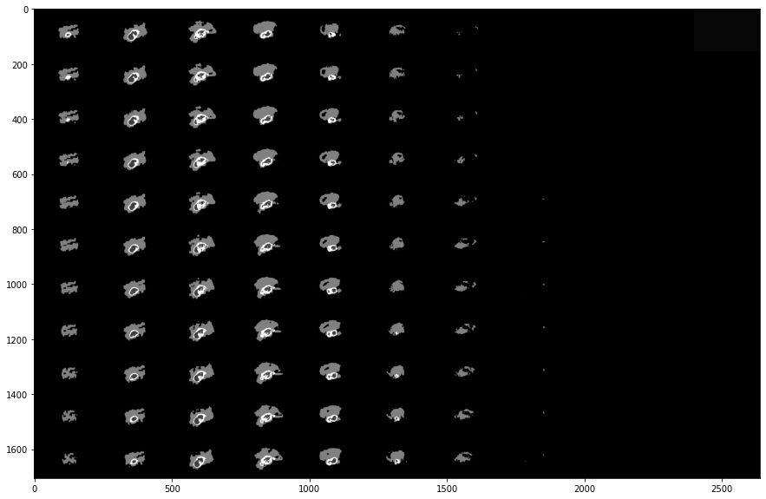
Data Visualisation

Slide 16
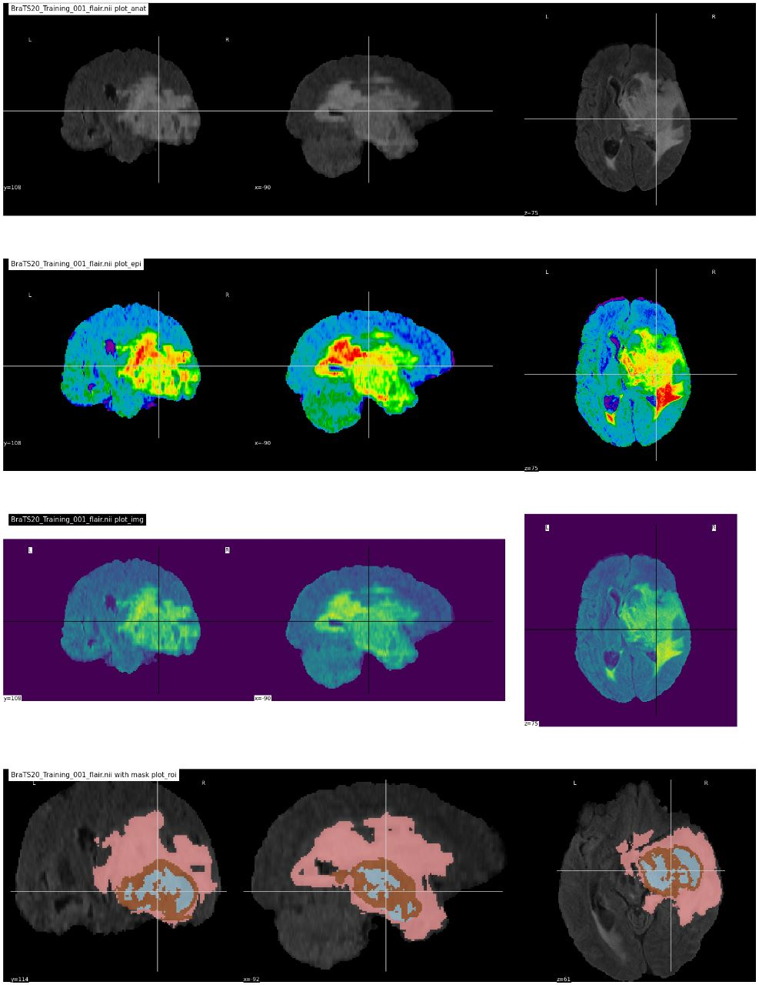
Data Visualisation

Slide 17
Algorithm Used
Procured dataset and applied necessary pre-processing and split the data into batches for training
Build the Unet Encoder Decoder architecture (for both 2D & 3D kernels)
Connects a series of contracting and expanding paths
With Downsampling through maxpooling, and ReLU activation function
We employ mostly 3x3 kernel for 2D Conv and 3x3x3 for 3D Convolutions
Following are the model specifications:-
->UNET CNN with 4 Layers of downsampling, concatenation, and 4 Layers of Up convolutions
->Categorical cross entropy loss
->Initial learning rate 10^-3
->Recorded Metrics:
Mean IOU
Class-wise Dice
Sensitivity, Specificity, Precision
->Stochastic Weighted Averaging when the LR cools down

Slide 18
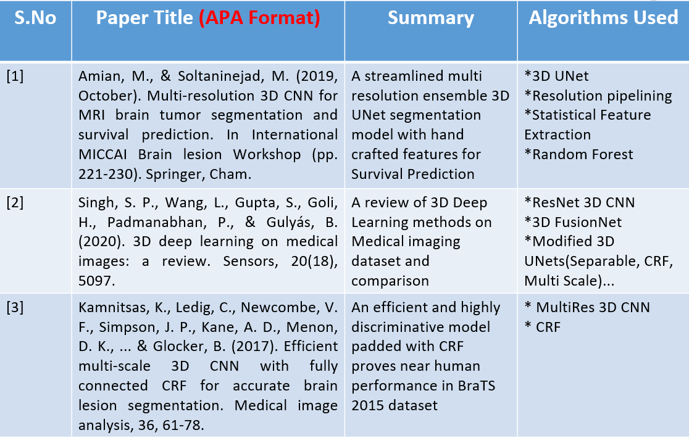
Comparison of Models
[All the papers reviewed: [15] Link to papers*]

Slide 19
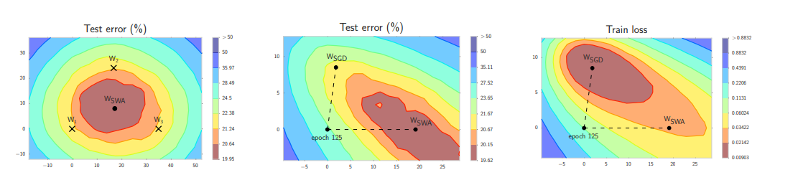
Stochastic Weight Averaging
Paper: Averaging Weights Leads to Wider Optima and Better Generalization

Slide 20
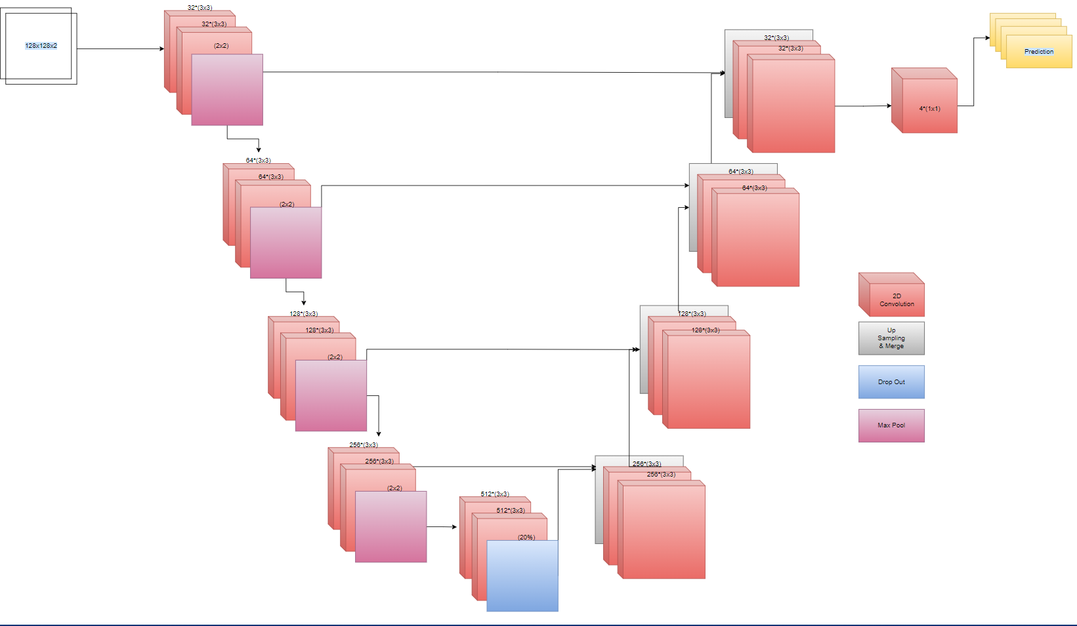
2D UNet Architecture

Slide 21
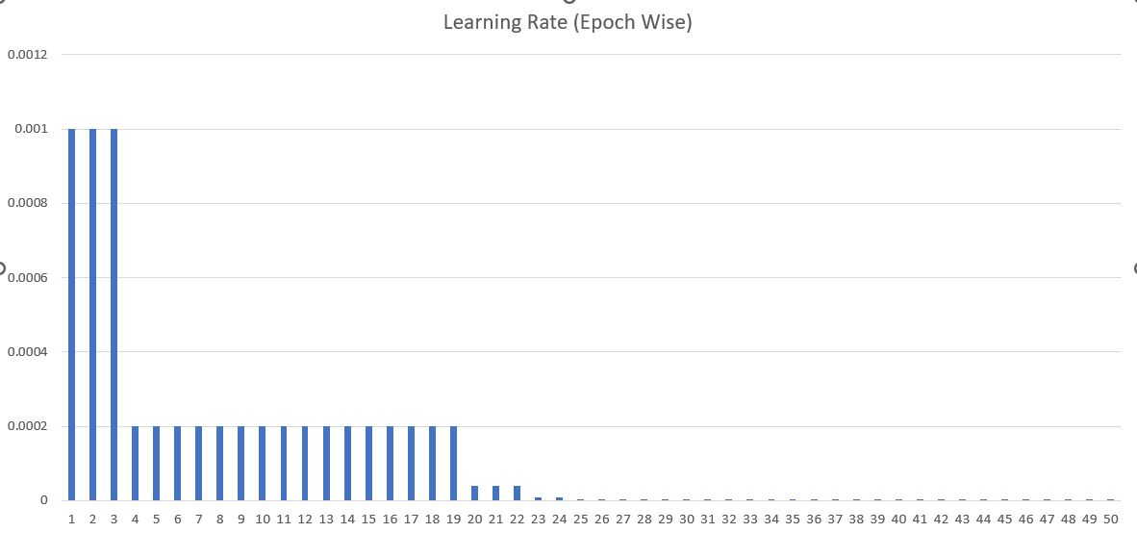
Learning Rate(epoch wise)

Slide 22
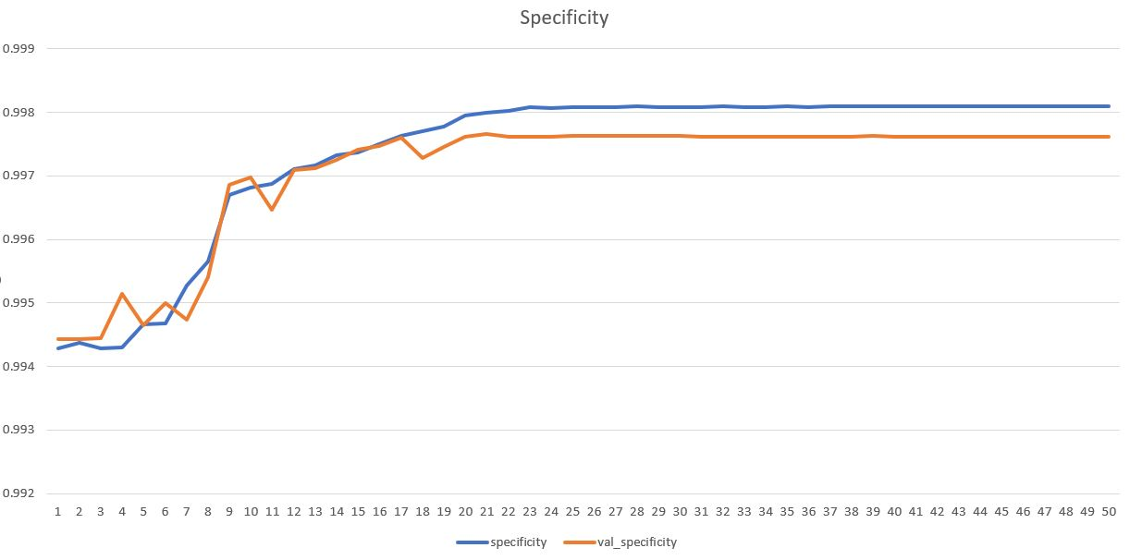
Specificity

Slide 23
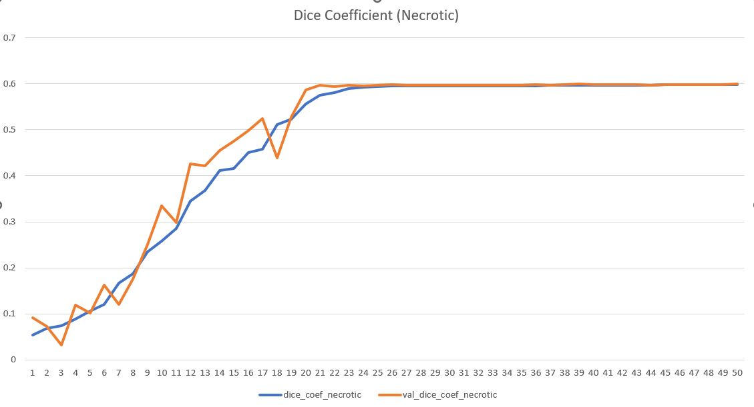
Dice Coefficient(Necrotic)

Slide 24
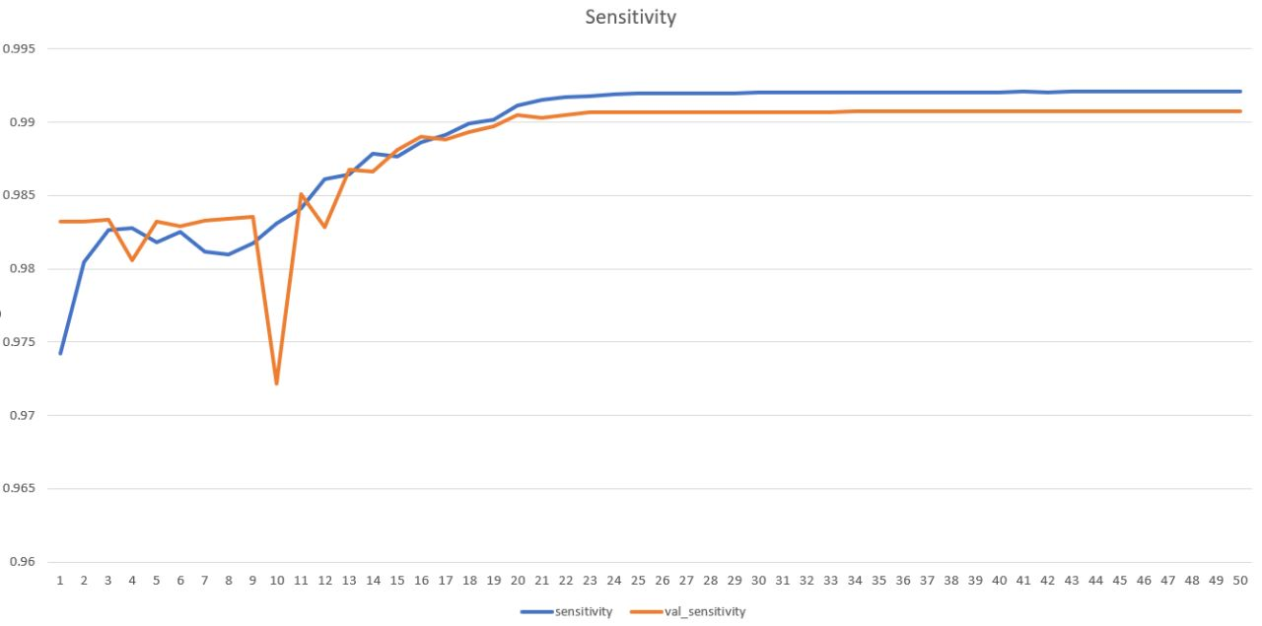
Sensitivity

Slide 25
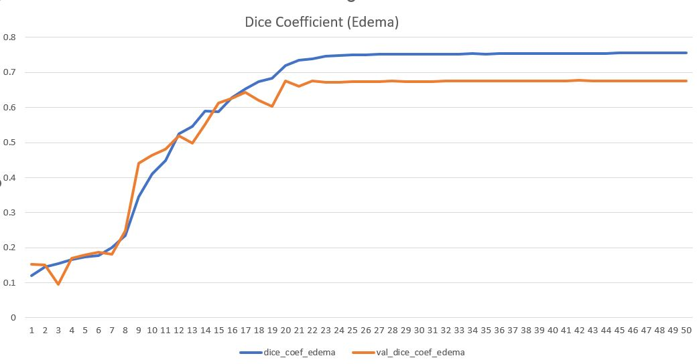
Dice Coefficient(Edema)

Slide 26
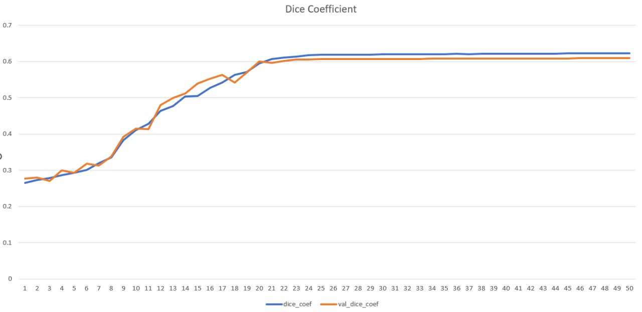
Dice Coefficient

Slide 27
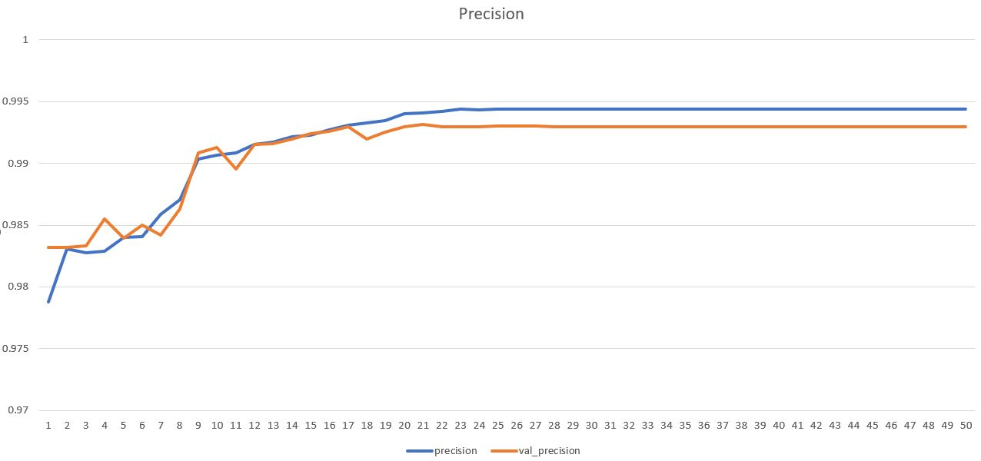
Precision

Slide 28
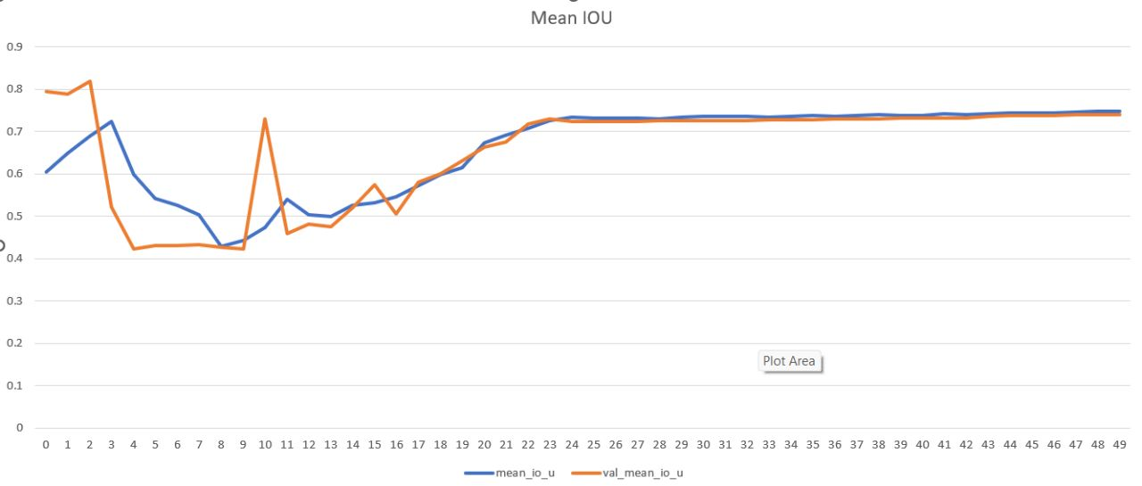
Mean IOU

Slide 29
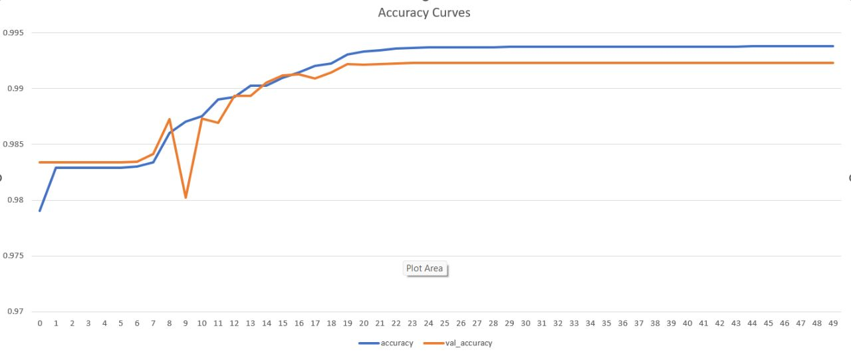
Accuracy Curves

Slide 30
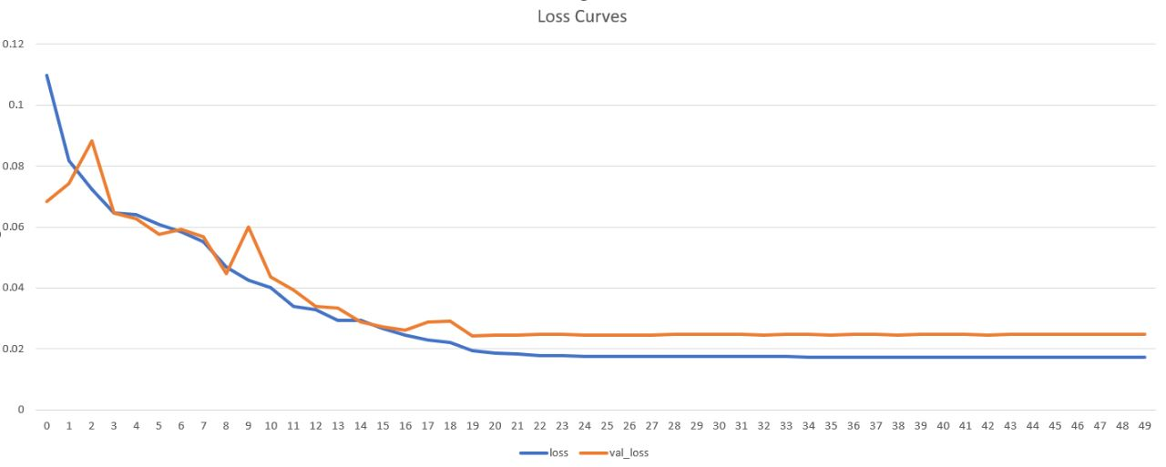
Loss Curves

Slide 31
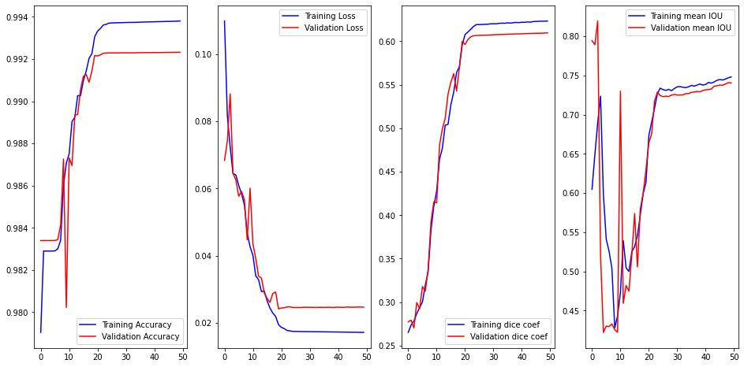
Training and Validation

Slide 32
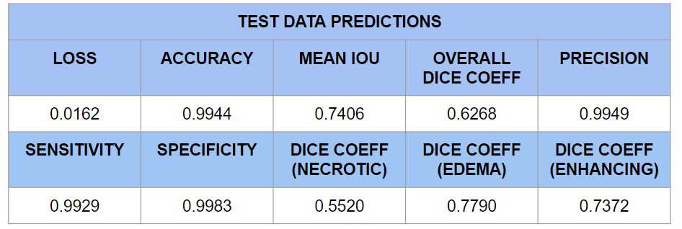
Test Data Predictions

Slide 33
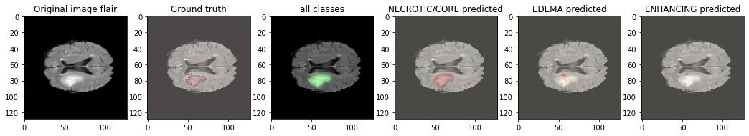
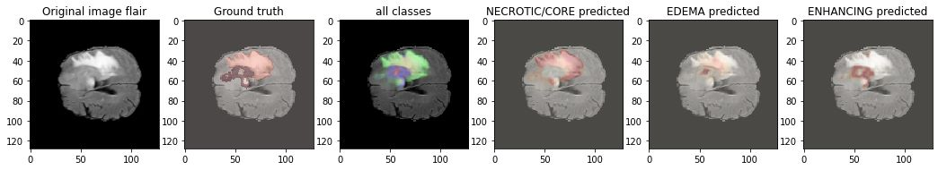
Predictions

Slide 34
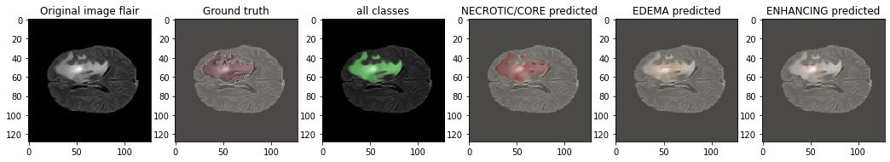
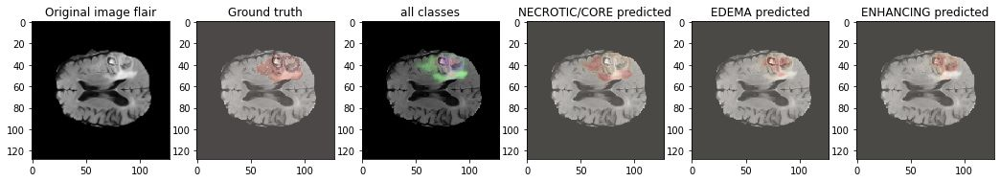
Predictions

Slide 35
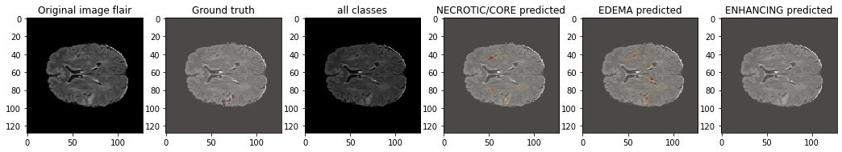
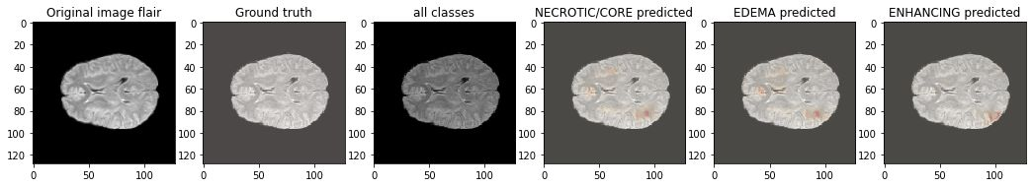
Predictions

Slide 36
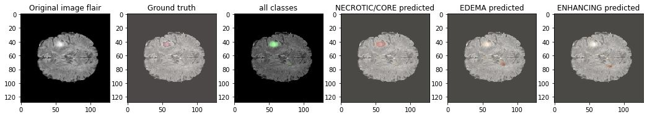
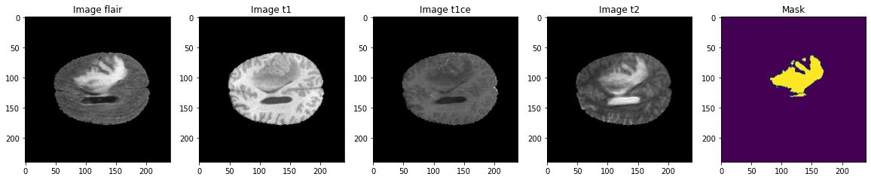
Predictions

Slide 37
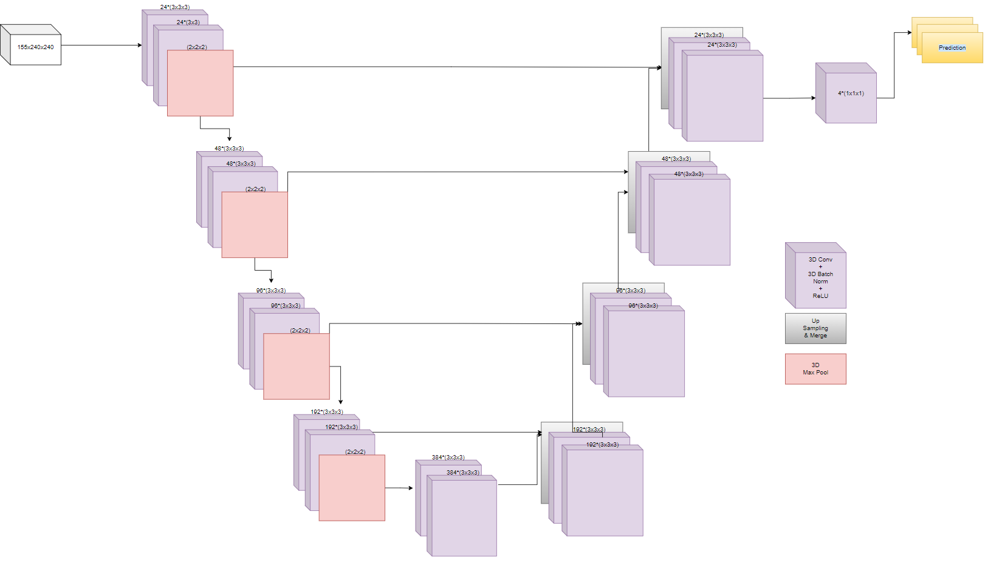
3D UNet Architecture

Slide 38
Cross Entropy Dice Loss

Slide 39
Dice Curve

Slide 40
Jaccard

Slide 41
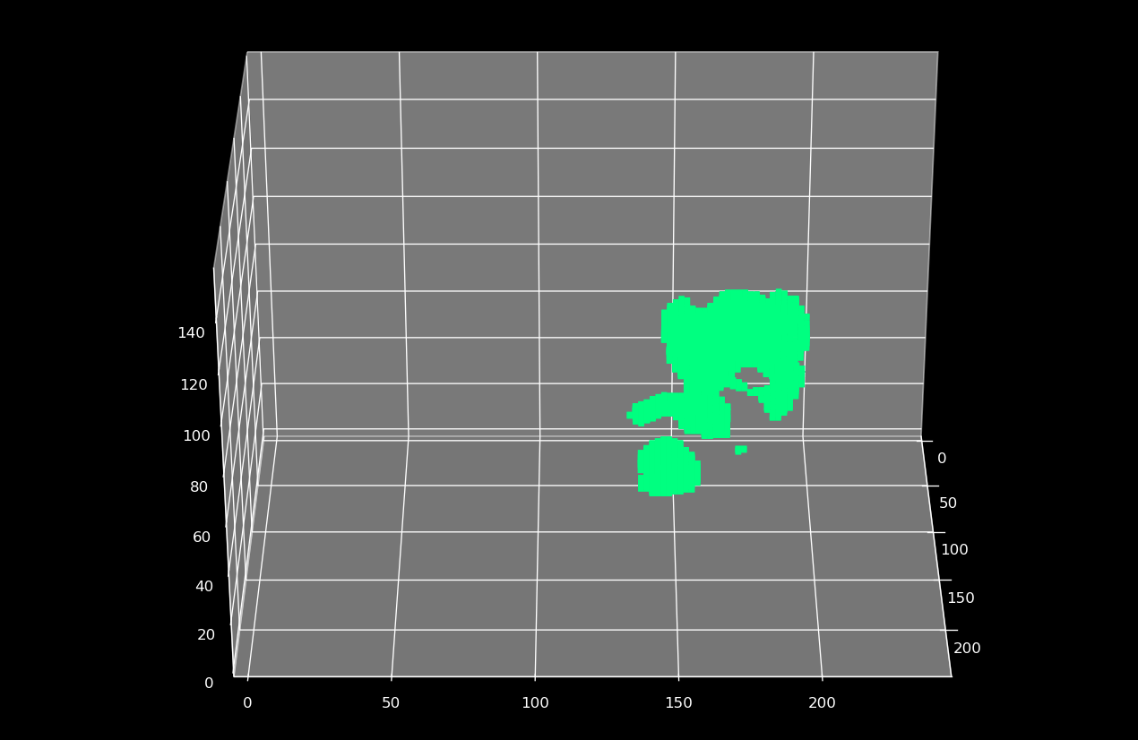
Prediction

Slide 42
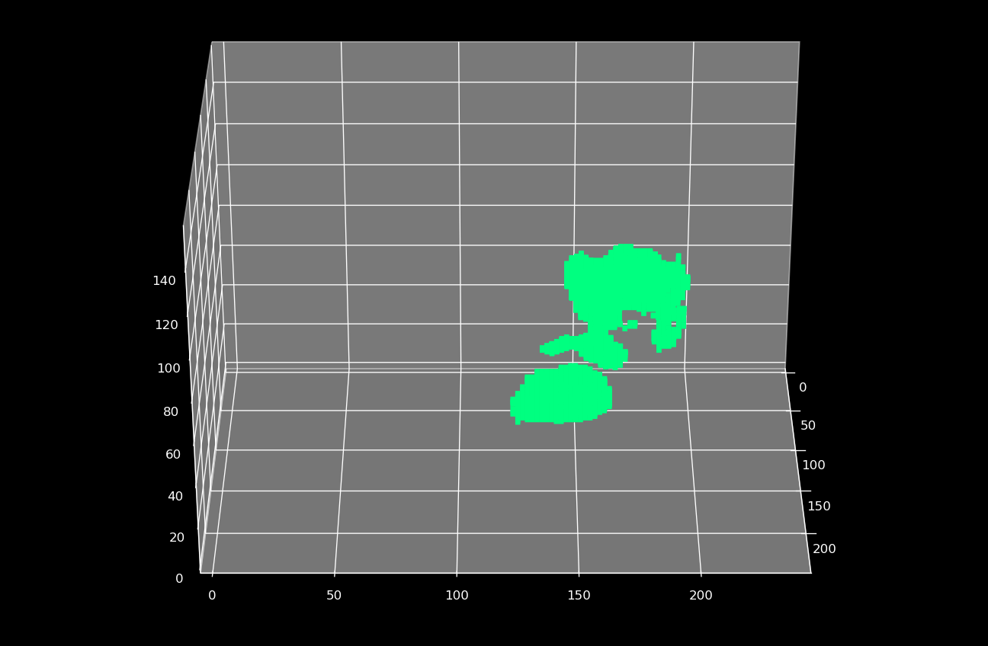
Ground Truth

Slide 43
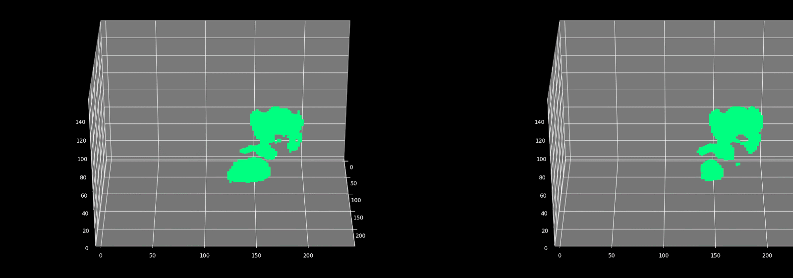
Results
Ground Truth
Prediction

Slide 44
Our Learning
The following listed are key learnings:
Procuring quality 3D Medical Imaging dataset
Data preprocessing and cleaning for 3D Scans
Deep NN architecture design
Surveying Model compression techniques for resolving size issues and inference time
Employing Stochastic Weighted Averaging for better performance and generalisations
Exploring business use case for medical image segmentation

Slide 45
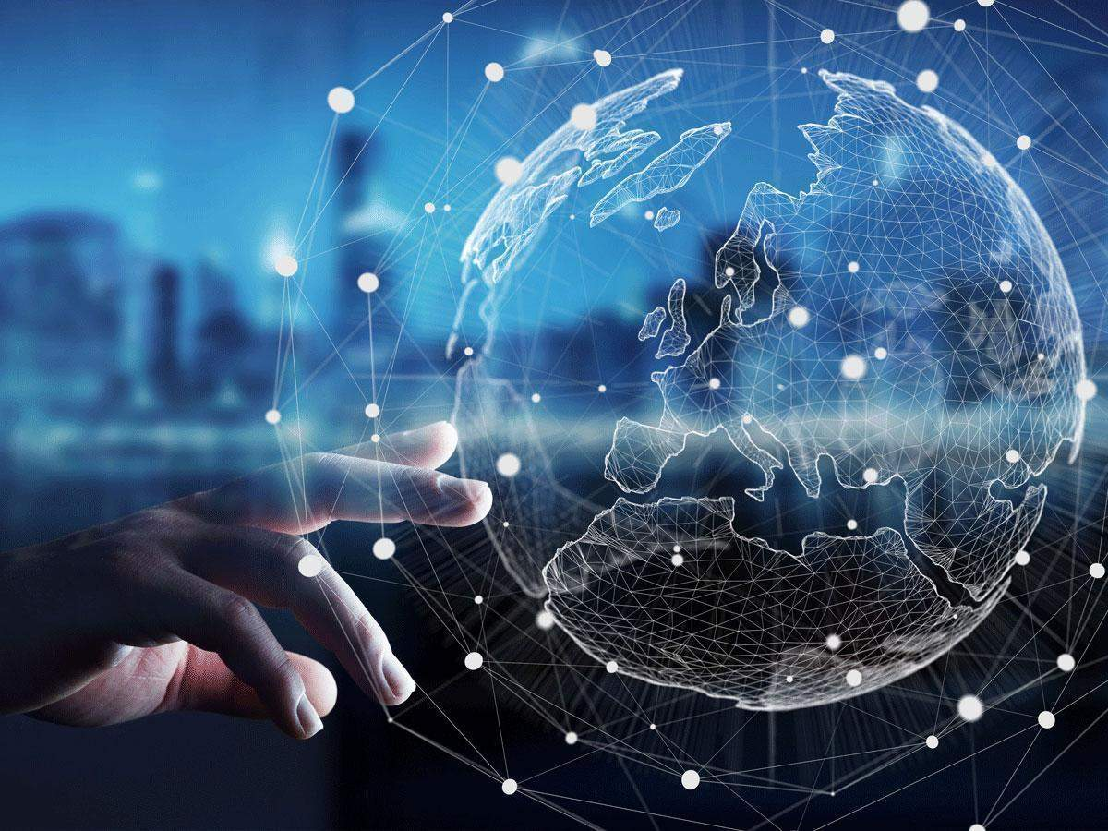
Future Enhancements
Data augmentation
Inter-modality-Transformation using GANs
Network Architecture Search
Compression with SVD for VR applications
Deploying in VR goggles

Slide 46
Weights & Biases
Photo
Thank You

